Slide 1


Slide 2



An Exclusive AD LOUNGE Event
Do you find recruiting young industry talent time consuming?
The NEXT GEN DINNER SERIES
can be your fresh new approach to recruiting young talent.
Top Emerging Talent in the Industry
+
=

Slide 3
An Exclusive AD LOUNGE Event
An Exclusive AD LOUNGE Event
OUR PROCESS
STEP 1
STEP 2
STEP 4
FINALE
300+ students from Marketing, Advertising, Technology, Design and Communications programs apply.
The top 100 are selected by a committee and invited for an in-person interview.
STEP 3
Winners trained by Combustion Creativity on Personal Branding and Networking skills and etiquette.
Next Gen Dinner Event!
Top 63 are selected

Slide 4
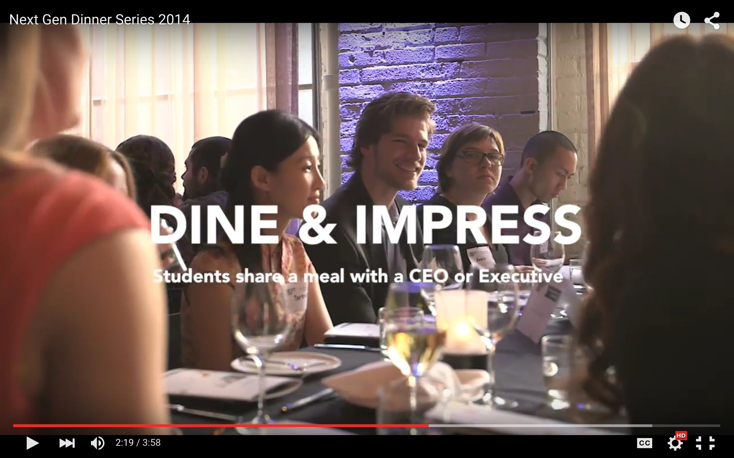
An Exclusive AD LOUNGE Event
An Exclusive AD LOUNGE Event
Dinner Series 2014, let’s see what its all about!

Slide 5
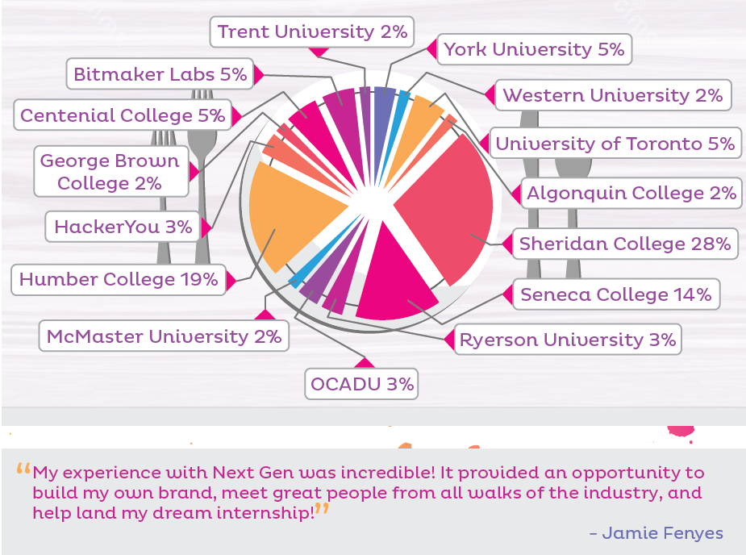
An Exclusive AD LOUNGE Event
CANDIDATE PROFILES
Educational Background
Design (Interactive & Graphic Design)
Advertising
Web Development/
Programming
MBA
Marketing Management
Public Relations
Schools at Dinner Series 2014

Slide 6
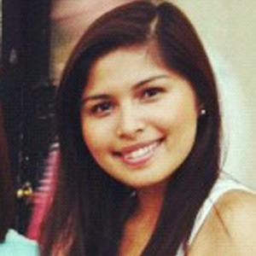
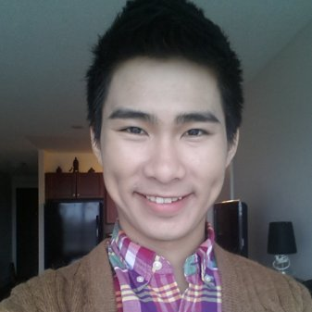
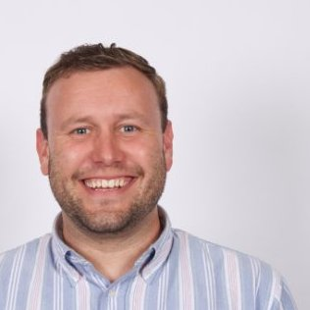
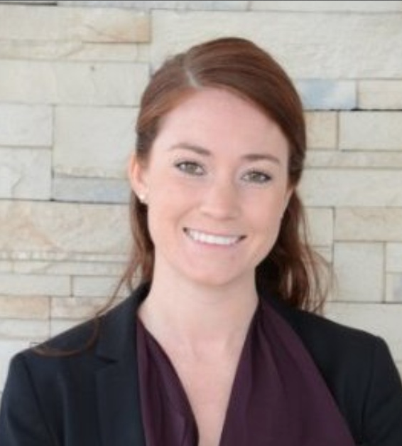







YOU CAN FIND OUR PAST CANDIDATES WORKING WITH ORGANIZATIONS SUCH AS:
An Exclusive AD LOUNGE Event
OUR PAST CANDIDATES
Our Talent from past events and where they are now:
Hazel de Vela
Account Executive
LEO BURNETT
Shin Phan
Marketing Coordinator
MAPLE LODGE FARMS
Matthew Lee
Copywriter
MACLAREN MCCANN
Lauren Burke
Asst. Marketing Manager
PEPSI CO.
Allison Miceli
Marketing Manager
HOLT RENFREW
Janice Law
Designer
TRIBAL WORLDWIDE

Slide 7
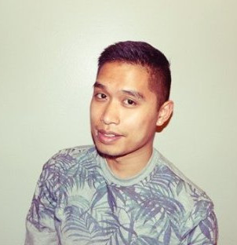
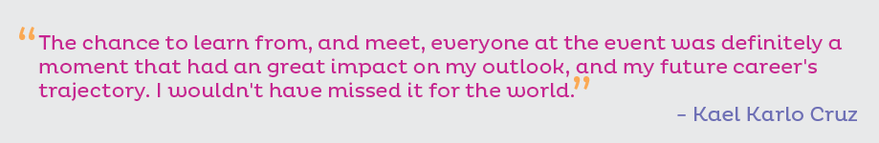

An Exclusive AD LOUNGE Event
An Exclusive AD LOUNGE Event
WHY DO WE NEED YOU?
Dinner Series is a competition for business, marketing, advertising, media, design and web development students to compete for their chance to have dinner with YOU!
We need your industry experience to mentor and sculpt the minds of tomorrow.
Invest in the future by sponsoring a table at the Next Gen Dinner Series 2016.
7 Tables
7 Categories
7 Industry Leaders
Art Director

Slide 8
An Exclusive AD LOUNGE Event
An Exclusive AD LOUNGE Event
POTENTIAL SPONSOR CATEGORIES
Product Design & Technology
Technical Builders
Integrated Minds
Entrepreneurial Minds
Digital Creative Minds
Strategic Thinkers
Brand & Marketing Management
Innovation
Don’t find a category that suit your business?
We’re happy to create one that will !

Slide 9
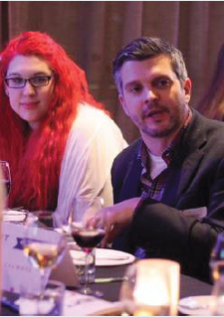
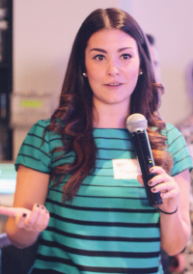
An Exclusive AD LOUNGE Event
TABLE SPONSORSHIP
Talent Management
Access to top talent, pre-screened specifically to match your requirements, before most companies reach them.
Interviews with Top Candidates to find talent that match your company values and roles you are looking to hire for.
One representative from your organization to dine with 9 pre-screened candidates selected just for you, seated at your sponsored table.
You will receive a list of all candidates + their website URLs.
Brand Recognition
Logo recognition on all promotional material (campus email marketing, Ad Lounge email marketing, event signage, website, table, program booklet, on-site Power Point loop and press releases).
Opportunity to speak for five minutes before the dinner to all guests.
Opportunity to be interviewed for the event video. (distributed to 5,000 Ad Lounge members and 500 students)
Add your company swag to our gifts bag. (100 units)
Table Sponsorship - $2500 (Only 7 Tables Available)

Slide 10
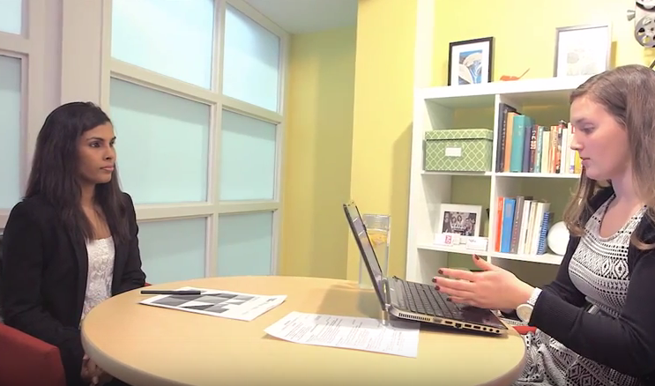
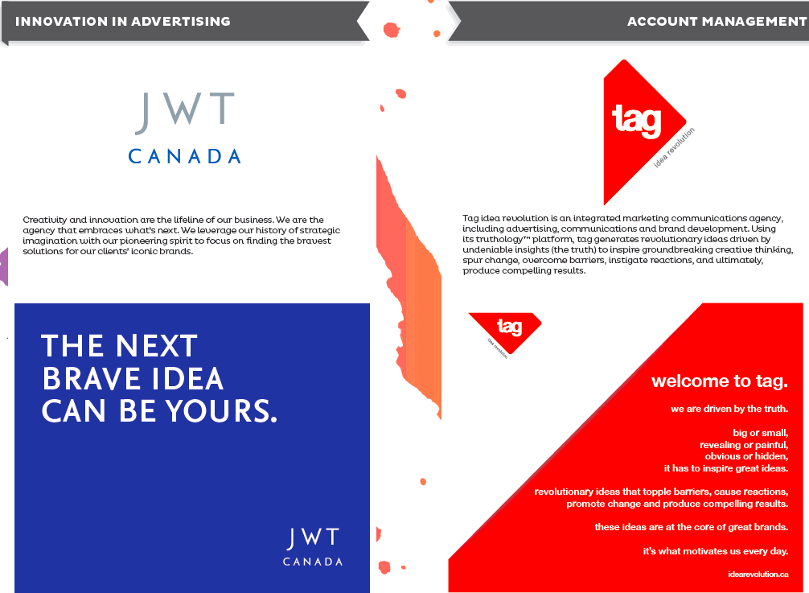
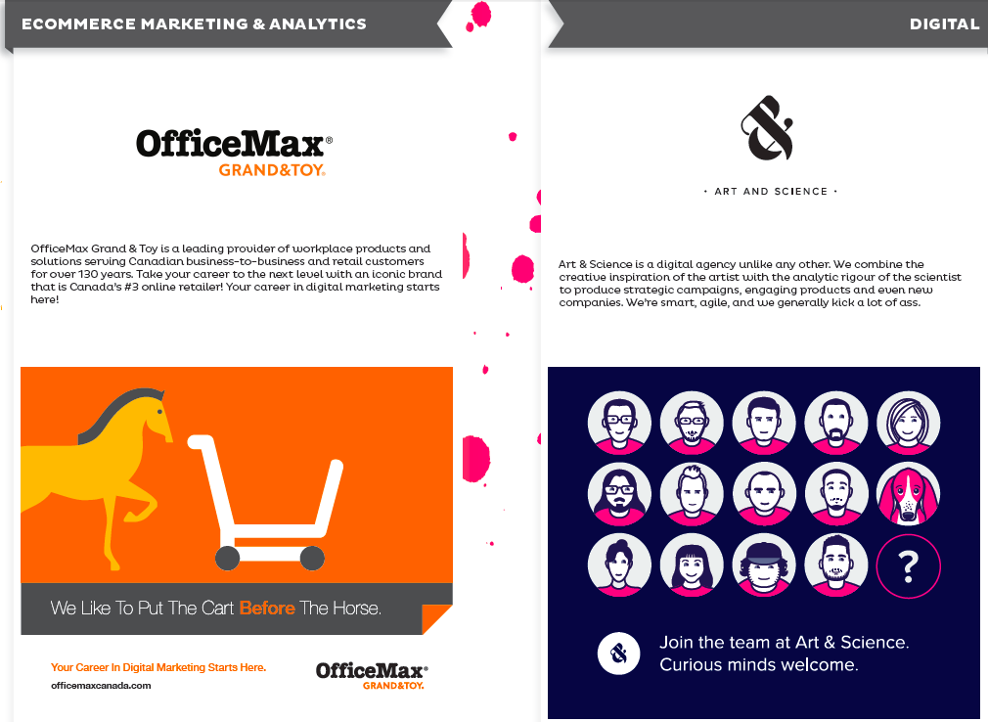
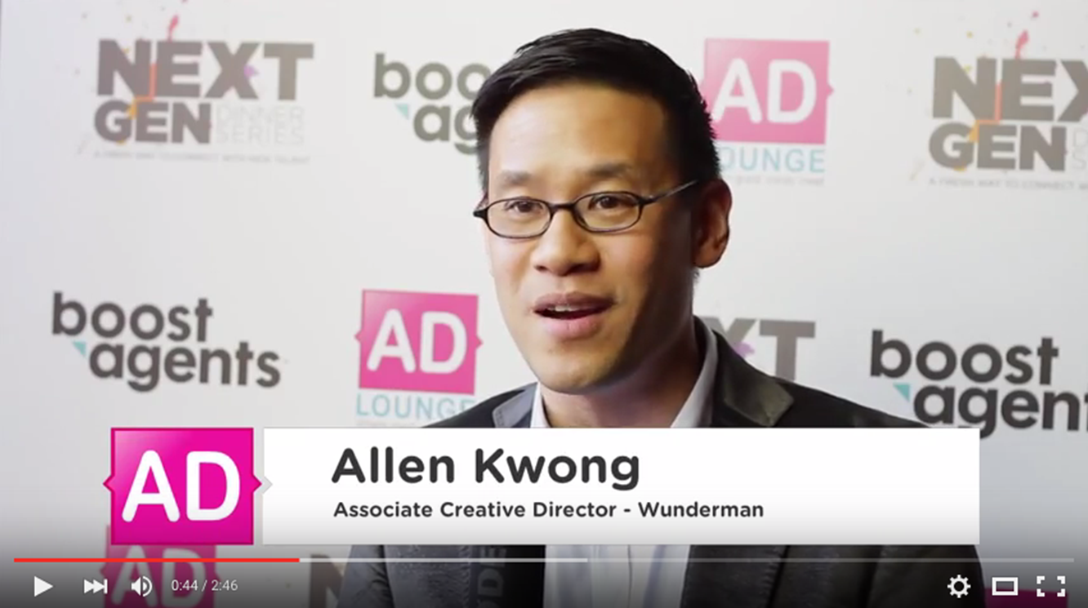
An Exclusive AD LOUNGE Event
Give Boost Agents your recruitment needs, they will find the top candidates for you.
Featured in Program Booklet with the option of an advertisement, company backgrounder and logo.
Opportunity for your company to be part of a media feature!

Slide 11


























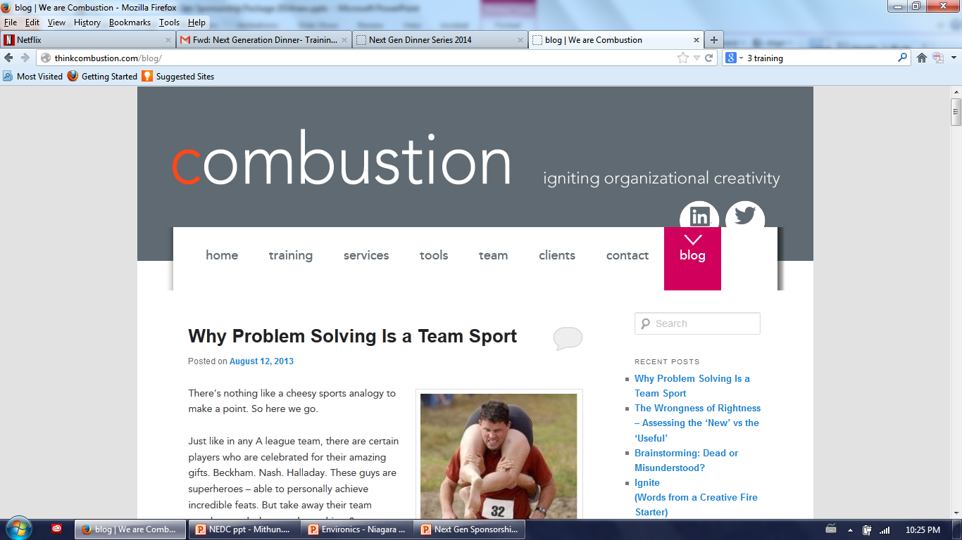



Past Sponsors
Past Sponsors

Slide 12
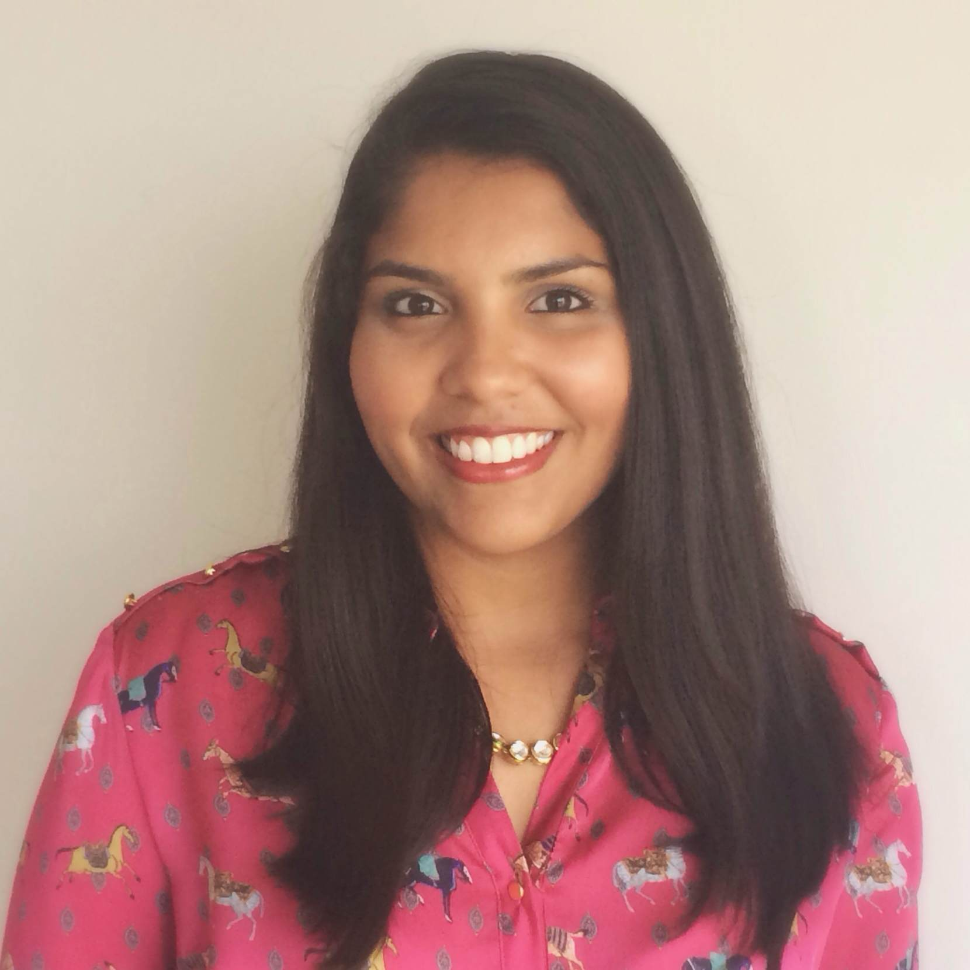
An Exclusive AD LOUNGE Event
An Exclusive AD LOUNGE Event
Let us know if you would like to know more or
have any questions!
Contact Us:
Tanya Baptista
Director of Sponsorship
Next Gen Dinner Series Attendee 2013
+1 (647) 760 8020
tanya@adlounge.ca www.adlounge.ca/dinnerseries

